Slide 1

STATICS

Slide 2
Steps to Write ML Models
Import the Data
Clean the Data / python(EDA) / PowerQuery
Split the Data into Training / Test Sets
Create a Model
Train the Model
Make Predictions
Evaluate and Improve
Data Visualization

Slide 3
UNIT II: Descriptive Statistics
Data representation, types of data- nominal, ordinal, interval and continuous.
Central tendency-calculating mean, mode, median, mean vs. median, variability, variance, standard deviation, Mean Absolute Deviation using sample dataset.
Finding the percentile, inter-quartile range, Box Plot, Outlier, whisker
Calculating correlation, covariance, causation.
Exploratory data analysis.
Data preparation and preprocessing, Data visualization.

Slide 4
UNIT II: Descriptive Statistics
Data representation, types of data- nominal, ordinal, interval and continuous.
Central tendency-calculating mean, mode, median, mean vs. median, variability, variance, standard deviation, Mean Absolute Deviation using sample dataset.
Finding the percentile, inter-quartile range, Box Plot, Outlier, whisker
Calculating correlation, covariance, causation.
Exploratory data analysis.
Data preparation and preprocessing, Data visualization.

Slide 5

What is Data?
Data refers to raw, unprocessed facts, figures, and statistics collected from various sources, which can be analyzed to gain insights and make decisions.
Data is the most important part of Machine Learning, Without data it is impossible to train any model and all modern research and automation will go in vain.
Data can be any value, text, sound, or picture i.e., structured or unstructured data(raw data).
Each row of a data set is called a record.
Each dataset will have multiple attributes, each of which gives information on a specific characteristic.
Attributes can also be termed as feature, variable, dimension, parameter or a field.

Slide 6
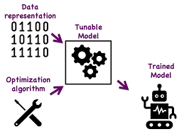
Data Representation in Machine Learning
Data representation refers to the way in which data is structured used by machine learning algorithms.
Since machine learning models learn patterns and make decisions based on data, it's essential to represent the data in a way that enables efficient learning and accurate predictions.
Proper representation of data can greatly influence model performance.

Slide 7
Why is Data Representation Important in Machine Learning?
Model Performance: Proper data representation can greatly enhance a machine learning model’s ability to learn patterns and generalize well to new data.
Handling Complex Problems: Advanced problems like natural language understanding, image recognition, or sequential forecasting require specialized data representations to capture the intrinsic structure of the data.
Efficiency: A good representation simplifies data storage, retrieval, and processing, making the machine learning pipeline more efficient.

Slide 8
Statistical Learning:
Statistics is a group of methods used to collect, analyze, present, and interpret data and to make decisions.
Types of Statistics
1. Descriptive statistics
2. Inferential statistics.

Slide 9
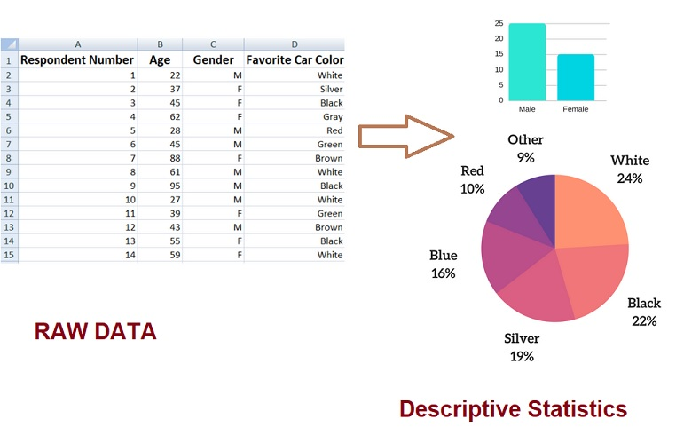
Descriptive statistics
Descriptive statistics describes, shows, and summarize the features of a dataset.
Descriptive statistics provides methods for organizing, visualizing, and presenting data meaningfully and informally.
It helps Data analysts to understand the data better.
Common measures and techniques in descriptive statistics include measures of central tendency and measures of dispersion
Notes:
9

Slide 10
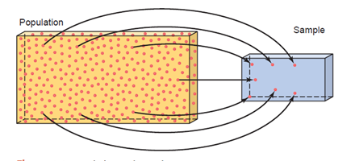
Inferential Statistics
In statistics, the collection of all elements of interest is called a population.
The selection of a few elements from this population is called a sample.
Inferential statistics consists of methods that use sample results to help make decisions or predictions about a population.
Example:
1.Exit Poll Survey
2. Rice Cooking

Slide 11
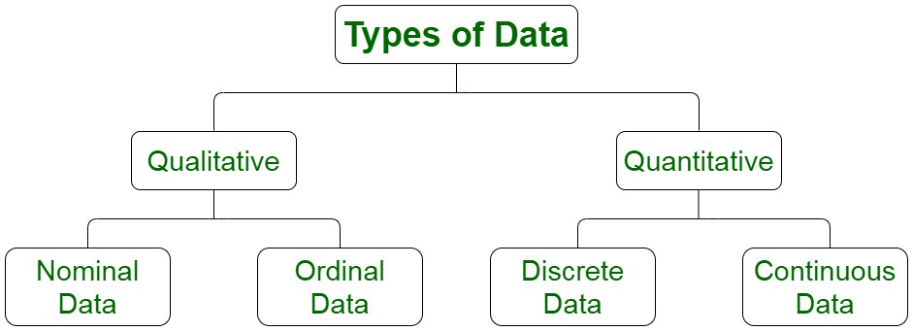

Slide 12


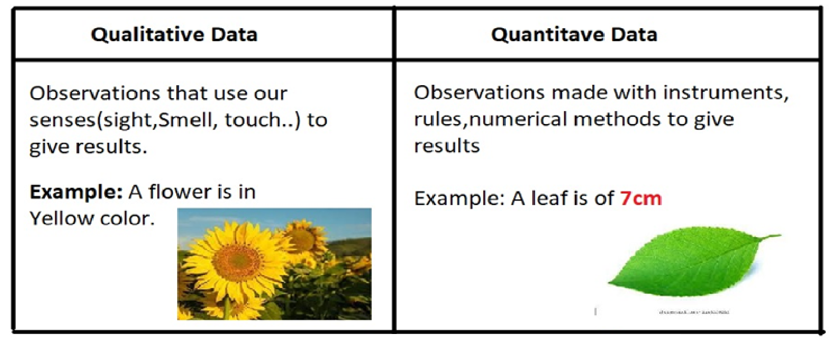

Slide 13
Qualitative Data or Categorical Data
Qualitative Data can’t be measured or counted in the form of numbers. i.e., sorted by category, not by number. also known as Categorical Data.
Qualitative Data may consist of audio, images, symbols, or text.
Examples: Gender: Male, Female. Product: Good or Bad.
Qualitative data tells about the perception of people. Which helps market researchers understand the customers’ tastes and then design their ideas and strategies accordingly.
The Qualitative data is further classified into two parts :
1. Nominal Data
2. Ordinal Data

Slide 14
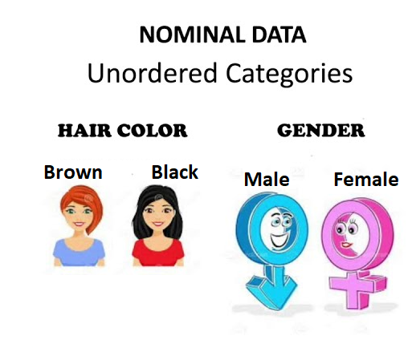
Nominal Data
Nominal Data is used to label variables without any order or quantitative value.
Numerical task such as Arithmetic operations can’t be performed on Nominal data.
Nominal Data don’t have any meaningful order, they are distributed to distinct categories.
Examples:
Marital status (Single,Married)
Nationality (Indian, German, American)
Gender (Male, Female)

Slide 15
Nominal Data
Machine Learning Usage: Nominal data are often represented as integers or one-hot encoded (a vector where one element is 1 and all others are 0) before being input into a machine learning model.
No mathematical operations can be applied to these data.

Slide 16

Ordinal Data
Ordinal data have categories with a clear ordering or ranking, but the distances between these categories are not equal or meaningful.
Examples:
2.Feedback System on a scale 1 to 10.
3. Assigning Ranks 1,2,3
4. Grading in Exam: A,B,C,D
Since ordering is possible in case of ordinal data, median, and quartiles can be identified Mean can still not be calculated.

Slide 17
Ordinal Data
Machine Learning Usage:
Ordinal data can be encoded using integer values that represent the order, but like nominal data, the difference between the values does not carry specific meaning.
Some algorithms may take the ordering into account (e.g., tree-based models like decision trees), but most models treat ordinal variables as categorical.

Slide 18
Quantitative Data or Numerical Data
Quantitative data relates to information about the quantity of an object
Quantitative data can be expressed in numerical values, which makes it countable and includes statistical data analysis.
Also known as Numerical data.
Quantitative data can be used for statistical manipulation and represented on a wide variety of graphs and charts such as bar graphs, histograms, scatter plots, boxplot, pie charts, etc.
Examples:
Height or weight of a person : 175cm
Room Temperature: 29 centigrade
Marks :59, 80, 60…
Time:2PM,6AM
The Quantitative data is further classified into two parts :
1.Discrete Data 2.Continuous Data

Slide 19
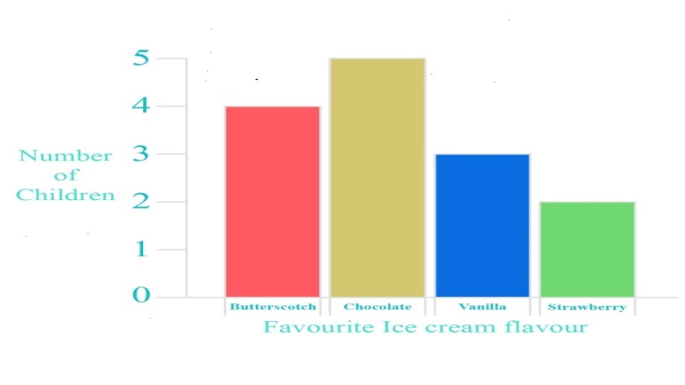
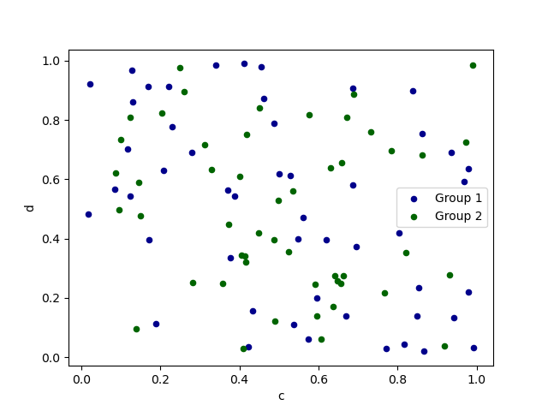
Discrete Data
Discrete means distinct or separate. The discrete data are countable and have finite values, their subdivision is not possible .i.e., can’t be broken into decimal or fraction values.
The discrete data contain the values that fall under integers or whole numbers.
Represented mainly by a bar graph, scatter plot ,etc.
Examples:
-Total no. of students present in a class.
-Numbers of employees in a company.
-Days in a week.

Slide 20
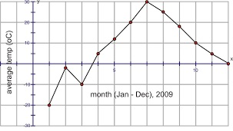
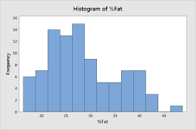
Continuous Data
Continuous data is data that can take any value within a range such as weight, length, temperature, speed, etc.
Continuous data can be in the form of decimal or fractional numbers.
Continuous data can be measured on an infinite scale, It can take any value between two numbers, no matter how small.
Represented mainly by a line plot , Histogram plot ,etc.
Examples:
Height of a person
Speed of a vehicle
Time-taken to finish the work

Slide 21
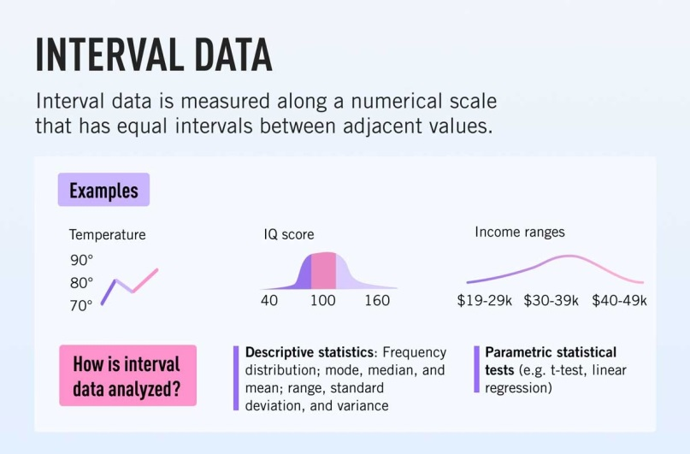
Interval Data
Interval data is numeric data for which not only the order is known, but the exact difference between values is also known.
The distance between the two points is equal i.e., equal interval between adjacent values.
Example: Celsius temperature, IQ Score , Income Ranges.
Addition & Subtraction operations can be performed on Interval data.
interval data do not have ‘true zero’ value.
Descriptive statistics which can be obtained using interval data include:
1.Central tendency: Mode, median, and mean
2. Dispersion: Range, Standard deviation and
variance

Slide 22
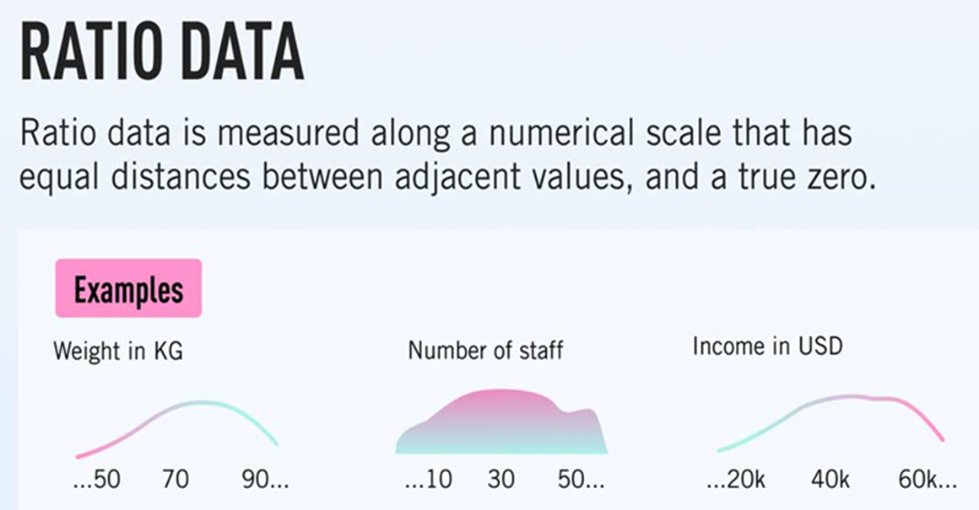
Ratio Data
Ratio data represents numeric data for which exact value can be measured.
Example: Distance Travelled, Age of a Person.
Absolute zero is available for ratio data.
Example: its possible to say 0km distance travelled
Ratio Data variables can be added, subtracted,
multiplied, or divided.
Descriptive statistics which can be obtained using Ratio data include:
1.Central tendency: Mode, median, and mean
2.Disperson: Range, Standard deviation and
variance

Slide 23
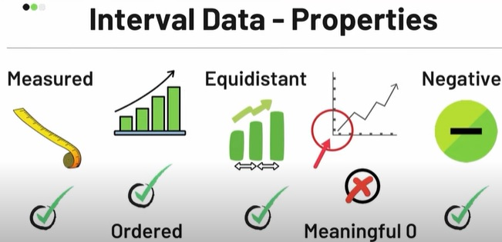
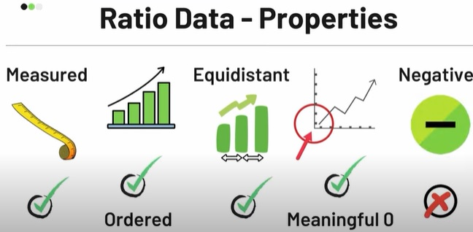
Interval & Ratio Data Properties
NOTE: In general, nominal and ordinal attributes are discrete. On the other hand, interval and ratio attributes are continuous, barring a few exceptions,
e.g. ‘count’ attribute.

Slide 24
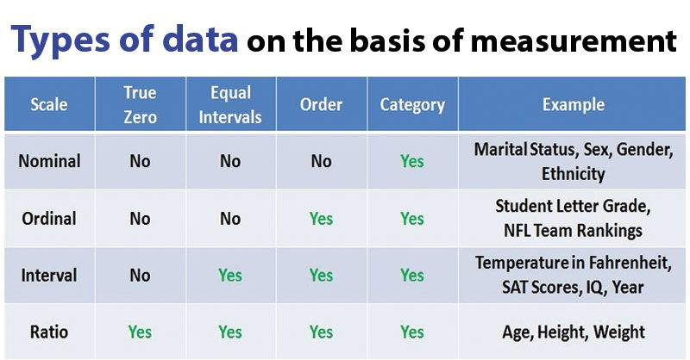

Slide 25
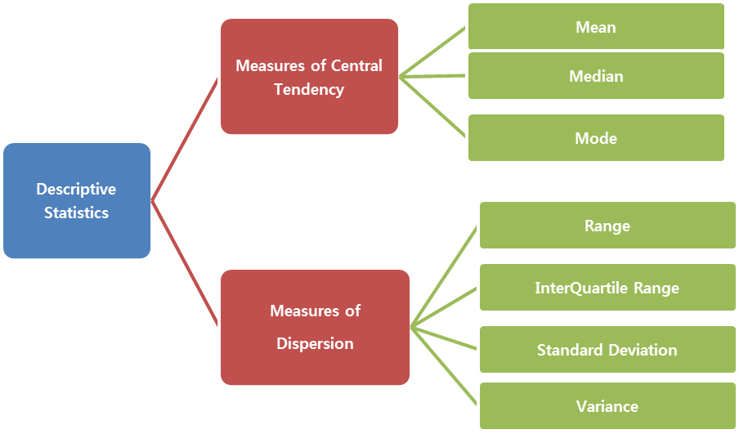

Slide 26
Central Tendency
Central tendency is defined as “the statistical measure that identifies a single value as representative of an entire distribution.
Central tendency is a one-number summary of the data that typically describes the center of the data. This one-number summary is of three types i.e., measures of central tendency.
Mean
Median
Mode

Slide 27
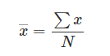
Mean
Mean is the arithmetic average of a data set. This is found by adding the numbers in a data set and dividing by the number of observations in the data set.
The Mean
where, ∑ represents the summation X represents observations N represents the number of observations .
It is also known as the arithmetic mean, and it is the most common measure of central tendency.
Arrangement or order of the numbers do not affect our calculation for mean.

Slide 28
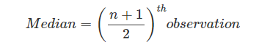
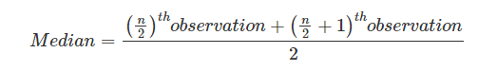
Median
The median is the middle number in a data set when the numbers are listed in either ascending or descending order.
If the total number of observations (n) is an odd number, then the formula is given below:
If the total number of the observations (n) is an even number, then the formula is given below:

Slide 29
Mode
The mode is the value that occurs the most often in a data set
Mode is the most frequently occurring sample.

Slide 30
P 1) Find the mean, median, mode, and range for the following list of values:
13, 18, 13, 14, 13, 16, 14, 21, 13
Solution:
Data given : 13, 18, 13, 14, 13, 16, 14, 21, 13
The mean is the average.
Mean = {13 + 18 + 13 + 14 + 13 + 16 + 14 + 21 + 13} / {9} = 15
(Note that the mean is not a value from the original list. This is a common result. You should not assume that your mean will be one of your original numbers.)
The median is the middle value, so rewrite the list in ascending order as given below:
13, 13, 13, 13, 14, 14, 16, 18, 21
There are nine numbers in the list, so the middle one will be
{9 + 1} / {2} = {10} / {2} = 5
= 5th number
Hence, the median is 14.
The mode is the number that is repeated more often than any other, so
13 is the mode .

Slide 31
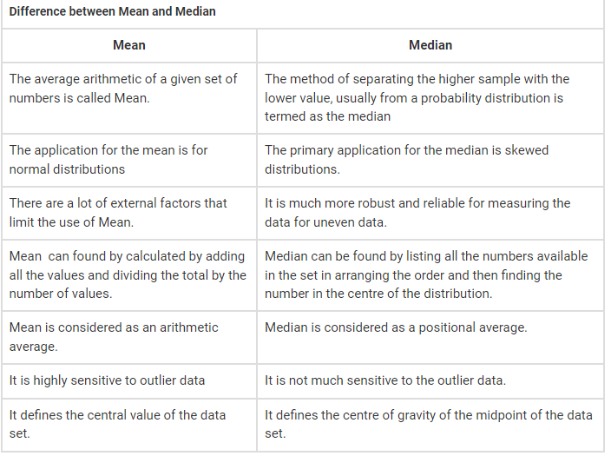

Slide 32
Understanding Data Distribution & measures central tendency
let’s consider a simple dataset to understand in better way.
Dataset1 = [1,2,2,3,3,3,4,4,4,4,5,5,5,5,5,6,6,6,6,6,6,7,7,7,7,7,7,7,8,8,8,8,8,8,8,8,9,9,9,9,9,9,9,10,10,10,10,10,10,11,11,11,11,11,12,12,12,12,13,13,13,14,14,15]
import warnings
warnings.filterwarnings('ignore')
import numpy as np
from scipy import stats
Dataset1 = [1,2,2,3,3,3,4,4,4,4,5,5,5,5,5,6,6,6,6,6,6,7,7,7,7,7,7,7,8,8,8,8,8,8,8,8,9,9,9,9,9,9,9,10,10,10,10,10,10,11,11,11,11,11,12,12,12,12,13,13,13,14,14,15]
x1=np.mean(Dataset1)
print(" The Average of Dataset is:",x1)
x2=np.median(Dataset1)
print(" The middle value of Dataset is:",x2)
x3 = stats.mode(Dataset1)
print(" Most frequently used value of Dataset is ",x3)

Slide 33
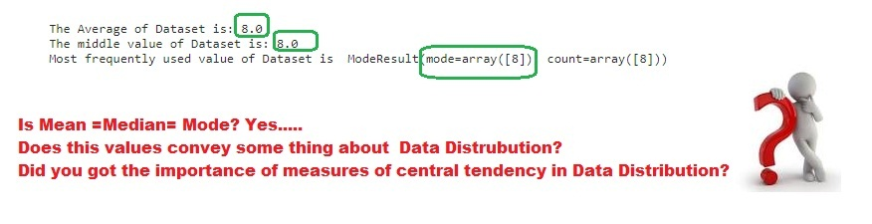

Slide 34
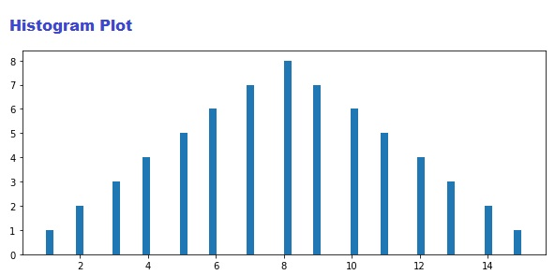
Lets understand with a plot
import numpy as np
import matplotlib.pyplot as plt
Dataset1 = [1,2,2,3,3,3,4,4,4,4,5,5,5,5,5,6,6,6,6,6,6,7,7,7,7,7,7,7,8,8,8,8,8,8,8,8,9,9,9,9,9,9,9,10,10,10,10,10,10,11,11,11,11,11,12,12,12,12,13,13,13,14,14,15]
y=Dataset1
plt.figure(figsize=(10, 4))
plt1 = plt.hist(Dataset1,bins=64)
plt.show()

Slide 35
Observation 1
If mean, mode and median are exactly the same then the data is distributed symmetrically i.e., normal distribution.
In a normal distribution, data is symmetrically distributed with no skew. Most values cluster around a central region.

Slide 36
Example 2
import warnings
warnings.filterwarnings('ignore')
import numpy as np
from scipy import stats
Dataset1 = [1,2,2,3,3,3,4,4,4,4,5,5,5,5,5,6,6,6,6,6,6,6,6,6,6,7,7,7,7,7,7,7,7,8,8,8,8,8,8,9,9,9,9,9,10,10,10,10,11,11,11,12,12,13,14,15]
x1=np.mean(Dataset1)
print(" The Average of Dataset is:",x1)
x2=np.median(Dataset1)
print(" The middle value of Dataset is:",x2)
x3 = stats.mode(Dataset1)
print(" Most frequently used value of Dataset is ",x3)

Slide 37
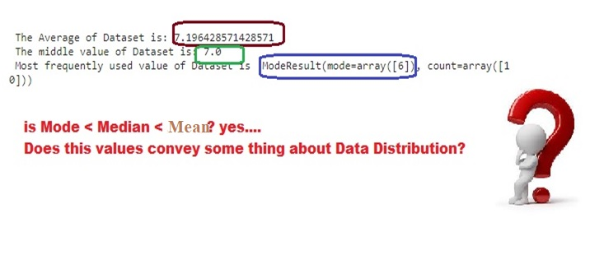

Slide 38
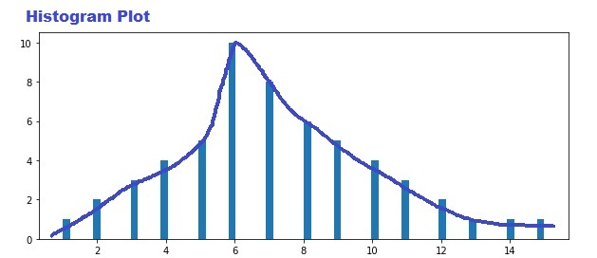
Lets understand with a plot
import numpy as np
import matplotlib.pyplot as plt
Dataset1 = [1,2,2,3,3,3,4,4,4,4,5,5,5,5,5,6,6,6,6,6,6,6,6,6,6,7,7,7,7,7,7,7,7,8,8,8,8,8,8,9,9,9,9,9,10,10,10,10,11,11,11,12,12,13,14,15]
y=Dataset1
plt.figure(figsize=(10, 4))
plt1 = plt.hist(Dataset1,bins=64)
plt.show()

Slide 39
Observation 2
If mode < median < mean then positively skewed distribution,
In a positively skewed distribution, there’s a cluster of lower scores and a spread out tail on the right.
It is Observed in histogram, distribution is skewed to the right, and the central tendency of dataset is on the lower end of possible scores.

Slide 40
Example 3
import warnings
warnings.filterwarnings('ignore')
import numpy as np
from scipy import stats
Dataset1 = [1,2,2,3,3,3,4,4,4,4,5,5,5,5,5,6,6,6,6,6,6,7,7,7,7,7,7,7,8,8,8,8,8,8,8,8,9,9,9,9,9,10,10,10,11,11,12]
x1=np.mean(Dataset1)
print(" The Average of Dataset is:",x1)
x2=np.median(Dataset1)
print(" The middle value of Dataset is:",x2)
x3 = stats.mode(Dataset1)
print(" Most frequently used value of Dataset is ",x3)

Slide 41
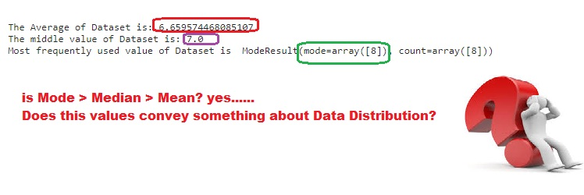

Slide 42
Lets understand with a plot
import numpy as np
import matplotlib.pyplot as plt
Dataset1 = [1,2,2,3,3,3,4,4,4,4,5,5,5,5,5,6,6,6,6,6,6,7,7,7,7,7,7,7,8,8,8,8,8,8,8,8,9,9,9,9,9,10,10,10,11,11,12]
y=Dataset1
plt.figure(figsize=(10, 4))
plt1 = plt.hist(Dataset1,bins=64)
plt.show()

Slide 43
Observation 3
In a negatively skewed distribution, mean < median < mode.
In a negatively skewed distribution, there’s a cluster of higher scores and a spread out tail on the left.
In this histogram, distribution is skewed to the left, and the central tendency of dataset is towards the higher end of possible scores.

Slide 44
When should you use the mean, median or mode?
For normally distributed data, all three measures of central tendency will give you the same answer so they can all be used but mean is the most widely used for normal distributed data.
In skewed distributions, the median is the best measure because it is unaffected by extreme outliers or non-symmetric distributions of scores. The mean and mode can vary in skewed distributions.
The mode can be used for any level of measurement, but it’s most meaningful for nominal and ordinal levels.
The median can only be used on data that can be ordered – that is, from ordinal, interval and ratio levels of measurement.
The mean can only be used on interval and ratio levels of measurement because it requires equal spacing between adjacent values or scores in the scale.

Slide 45
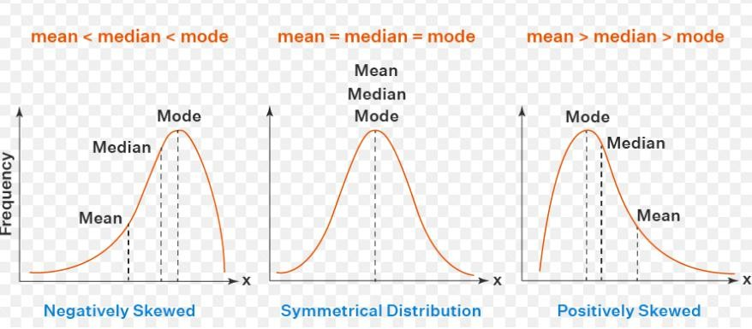

Slide 46
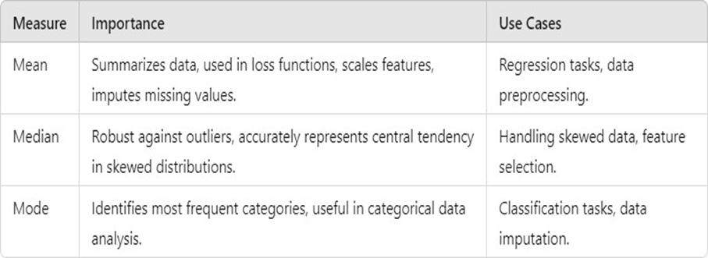

Slide 47
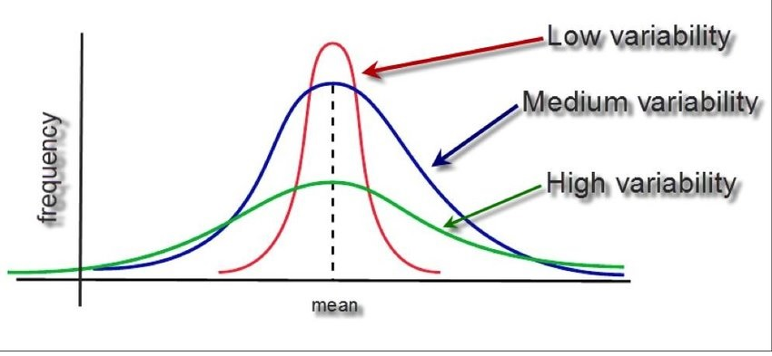
Variability/Dispersion
Variability (also called spread or dispersion) refers to how a data of each attribute is spread out in a dataset.
The four main ways to describe variability in a data set are:
• range
• Variance
• Standard deviation.
• Interquartile range

Slide 48
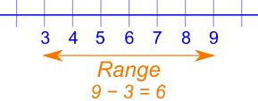
Range
In statistics, the range is the spread of your data from the lowest to the highest value in the distribution.
It is a commonly used measure of variability.
The range is calculated by subtracting the lowest value from the highest value.
large range means high variability, a small range means low variability in a distribution.
For example, if the given data set is {2,5,8,10,3}, then the range will be 10 – 2 = 8.

Slide 49
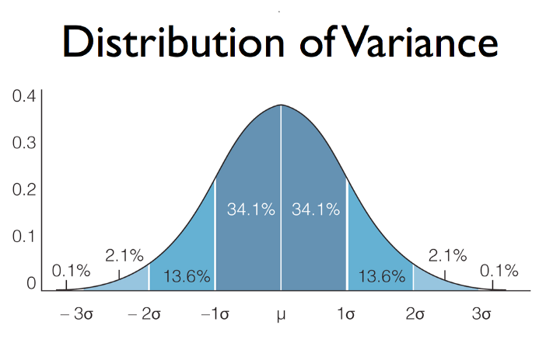
Variance
Variance is a measure of how data points differ from the mean.
A small variance indicates that the data points tend to be very close to the mean.
A high variance indicates that the data points are very spread out from the mean.
Therefore, it is called a measure of spread of data from mean.
Variance is the average of the squared distances from each point to the mean.

Slide 50
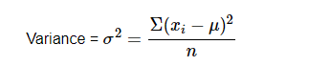
Variance
Variance is the sum of squares of differences between all numbers and means( µ). The mathematical formula for variance is as follows
where: xi = Each Sample
µ = Mean
n= total number of samples
Variance is a simple measure of dispersion. Variance measures how far each number in the dataset is from the mean.

Slide 51
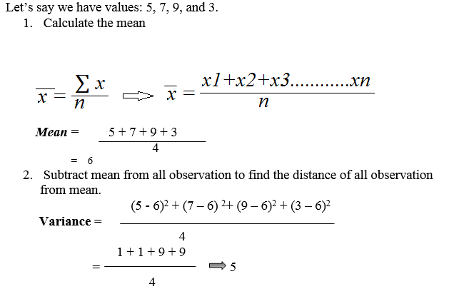
Example:

Slide 52
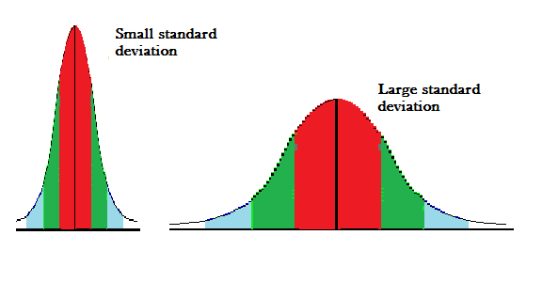
Standard Deviation
Standard deviation is a squared root of the variance to get original values.
small standard deviation means data are clustered around the mean, and high standard deviation indicates data are more spread out.

Slide 53
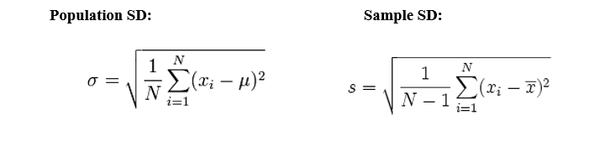

Slide 54
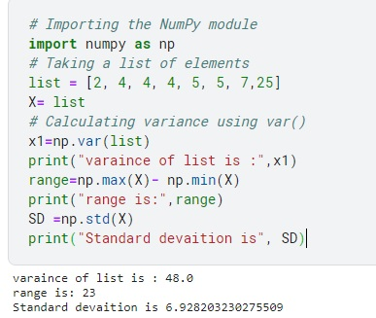
Finding measures of Variability on simple Data

Slide 55
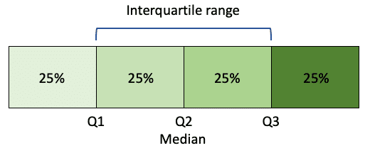
Interquartile Range
Interquartile Range, (IQR) is a property that is used to measure variability.
The IQR divides a dataset into quartiles. These quartiles store data after the data gets sorted in ascending order and split into 4 equal parts. The first, second, and third quartiles are called Q1, Q2, and Q3. These quartiles are the values that separate the 4 equal parts.

Slide 56
The following is the percentile distribution of the data amongst Q1, Q2, and Q3-
25th percentile of the data is represented in Q1
50th percentile of the data is represented in Q2
75th percentile of data is represented in Q3
The measurement of IQR gives an insight into the width of distribution as most of the points of the dataset are contained in this range.
In a dataset that contains even or odd elements of data points, then-
Q2 is the median
Q1 is the median of x smallest points of data i.e., lower half of data
Q3 is the median of x highest points of data i.e., Upper half of data

Slide 57
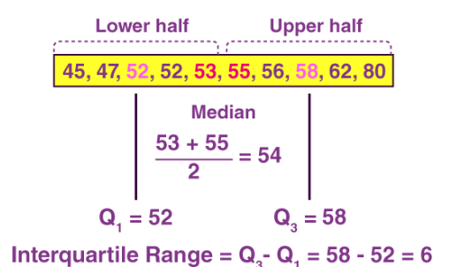
Example

Slide 58
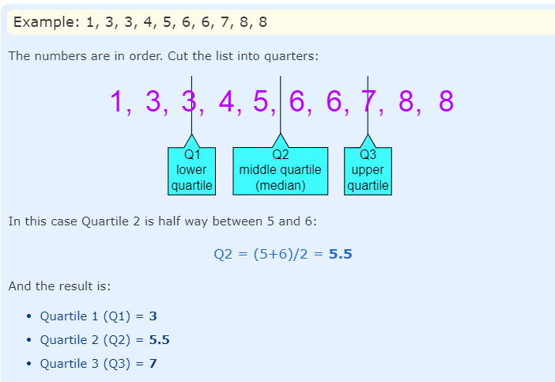

Slide 59
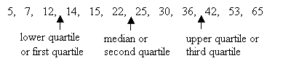
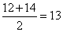
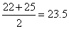
Find the median, lower quartile, upper quartile, interquartile range and range of the following numbers. 12, 5, 22, 30, 7, 36, 14, 42, 15, 53, 25, 65
Solution: First, arrange the data in ascending order:
Lower quartile or first quartile(Q1) =
Median or second quartile(Q2) =

Slide 60
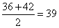
Upper quartile or third quartile(Q3) =
Interquartile range = Upper quartile – lower quartile = 39 – 13 = 26
Range = largest value – smallest value = 65 – 5 = 60

Slide 61
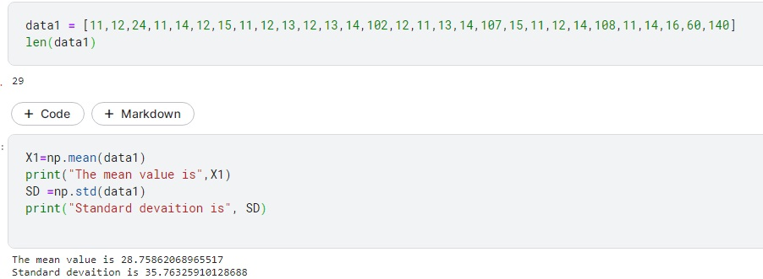
Lets Analyze outliers with simple Data

Slide 62
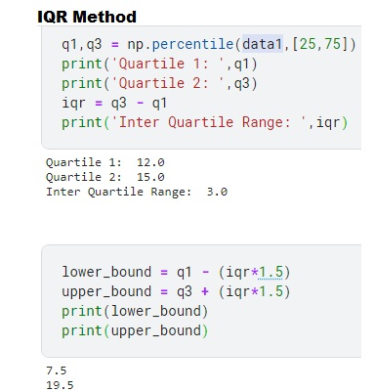

Slide 63
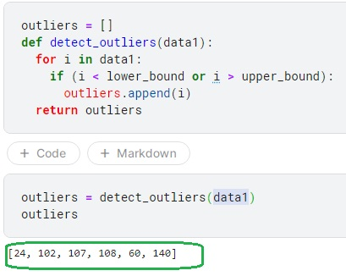

Slide 64
BOX PLOT
The box and whisker plot, sometimes simply called the box plot, is a type of graph that help visualize the five-number summary.
Box plots are a standardized way of displaying the distribution of data based on a five number summary (“minimum”, first quartile (Q1), median, third quartile (Q3), and “maximum”).
It doesn’t show the distribution in as much detail as histogram does, but it’s especially useful for indicating whether a distribution is skewed and whether there are potential unusual observations (outliers) in the data set.
A box plot is ideal for comparing distributions because the center, spread and overall range are immediately apparent.

Slide 65
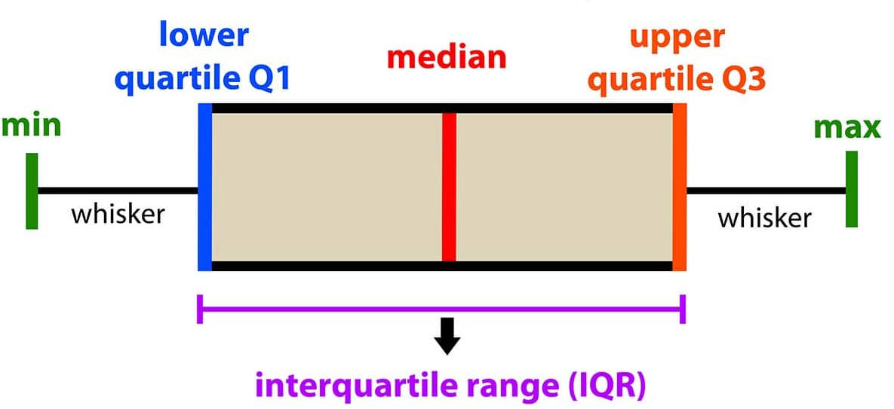

Slide 66
In a box and whisker plot:
The left and right sides of the box are the lower and upper quartiles. The box covers the interquartile interval, where 50% of the data is found.
The vertical line that split the box in two is the median. Sometimes, the mean is also indicated by a dot or a cross on the box plot.
The whiskers are the two lines outside the box, that go from the minimum to the lower quartile (the start of the box) and then from the upper quartile (the end of the box) to the maximum.
Box plot can be displayed in both vertical & horizontal pattern.

Slide 67
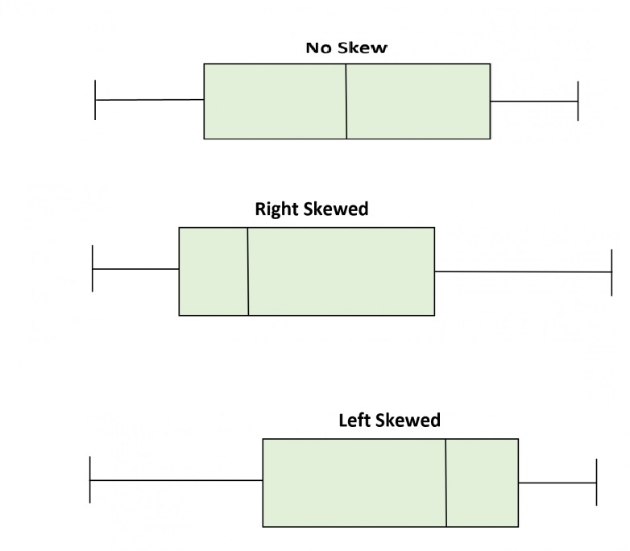
The box plot shape will show if a data set is normally distributed or skewed.
When the median is in the middle of the box, and the whiskers are about the same on both sides of the box, then the distribution is symmetric.
When the median is closer to the bottom of the box, and if the whisker is shorter on the lower end of the box,
and longer to the upper side then the distribution is positively skewed (skewed right).
When the median is closer to the top of the box, and if the whisker is shorter on the upper end of the box, then the distribution is negatively skewed (skewed left).

Slide 68
Outlier
Outliers are those data points that are significantly different from the rest of the dataset.
They are often abnormal observations that skew the data distribution, and arise due to incorrect data entry or false observations .
The outlier formula — also known as the 1.5 IQR rule — is a Thumb rule used for identifying outliers.
The outlier formula designates outliers based on an upper and lower boundary .i.e.,
Anything above Q3 + 1.5 x IQR is an outlier
Anything below Q1 - 1.5 x IQR is an outlier

Slide 69
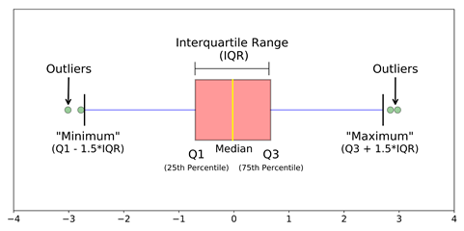

Slide 70
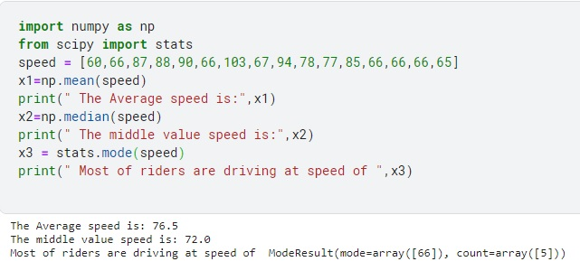
Finding measures of Central tendency on simple Data

Slide 71
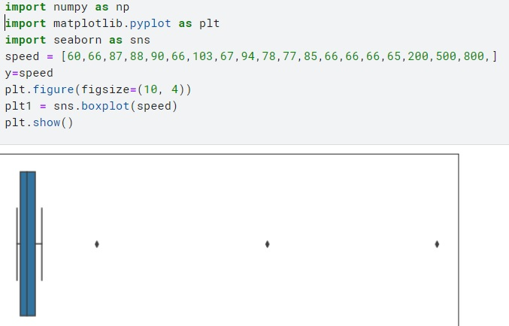
Finding Outliers Using Boxplot

Slide 72

Effect of Outliers on Central tendency measures
By comparing measures of central tendency on two datasets(without & with outliers) , It is evident that mean is most effected due to outliers.

Slide 73

Mean absolute deviation (MAD)
The mean absolute deviation (MAD) of a data-set is the average distance between each data point of the data-set and the mean of dataset. i.e it represents the amount of variation that occurs around the mean value in the data-set.
It is also a measure of variation.
It is calculated as the average of the sum of the absolute difference between each value of the data-set and the mean.

Slide 74

Suppose we have 4 values are 5, 7, 9, and 3.
MAD is the measure of spread (variability).
Here || gives the absolute value that means all negative deviation (distance) made positive.

Slide 75


Covariance
Covariance measures how two variables move with respect to each other .
The covariance between two random variables X and Y measure the degree to which X and Y are (linearly) related, which means how X varies with Y and vice versa.
Where,
x = the independent variable
y = the dependent variable
n = number of data points in the

Slide 76


The values of covariance can be any number between
A positive number signifies positive covariance and denotes that there is a direct relationship

Slide 77

A negative covariance which denotes an inverse relationship between the two variables.

Slide 78

When two variables are independent, the covariance will be zero

Slide 79
Example
X | Y
10 | 40
12 | 48
14 | 56
8 | 32

Slide 80
Step 1: Calculate Mean of X and Y
Mean of X : 10+12+14+8 / 4 = 11
Mean of Y = 40+48+56+32/4 = 44

Slide 81
xi –x̅ | yi – ȳ
10 – 11 = -1 | 40 – 44 = – 4
12 – 11 = 1 | 48 – 44 = 4
14 – 11 = 3 | 56 – 44 = 12
8 – 11 = -3 | 32 – 44 = -12

Slide 82

Substitute the above values in the formula
Cov(x,y) = l(-1) (-4)l +l(1)(4)l+l(3)(12)l+l(-3)(-12)l/4
Cov(x,y) = 80/3 = 26.6
Hence, Co-variance for the above data is 26.6

Slide 83
Correlation
Correlation is a method of statistical evaluation used to study the strength of a relationship between two numerically measured, continuous variables.
It not only shows the kind of relation (in terms of direction) but also how strong the relationship is.
Correlation values lies between -1 to +1
correlation values have standardized notions, whereas the covariance values are not standardized and cannot be used to compare how strong or weak the relationship is because the magnitude has no direct significance.

Slide 84


The result of a correlation is called the correlation coefficient.

Slide 85

Types of correlation
Positive correlation If with increase in random variable A, random variable B increases too, or vice versa.

Slide 86

Negative correlation If increase in random variable A leads to a decrease in B, or vice versa.

Slide 87

No correlation – When both the variables are completely unrelated and change in one leads to no change in other.

Slide 88
Example
X | Y
10 | 40
12 | 48
14 | 56
8 | 32

Slide 89


Step 1: Calculate Mean of X and Y
Mean of X : 10+12+14+8 / 4 = 11
Mean of Y = 40+48+56+32/4 = 44

Slide 90
xi –x̅ | yi – ȳ
10 – 11 = -1 | 40 – 44 = – 4
12 – 11 = 1 | 48 – 44 = 4
14 – 11 = 3 | 56 – 44 = 12
8 – 11 = -3 | 32 – 44 = 12

Slide 91
Substitute the above values in the formula
Cov(x,y) = l(-1) (-4)l +l(1)(4)l+l(3)(12)l+l(-3)(12)l/4
Cov(x,y) = 80/3 = 26.6
Hence, Co-variance for the above data is 26.6

Slide 92

Before substitution we have to find standard deviation of x and y
Lets take the data for X as mentioned in the table that is 10,12,14,8
To find standard deviation

Slide 93
Step 1: Find the mean of x that is x̄
10+14+12+8 /4 = 11
Step 2: Find each number deviation: Subtract each score with mean to get mean deviation
10 – 11 = -1
12 – 11 = 1
14 – 11 = 3
8 – 11 = -3
Step 3: Square the mean deviation obtained
Mean Deviation Value | Squared Mean Deviation Value
-1 | 1
1 | 1
3 | 9
-3 | 9

Slide 94
Step 4: Sum the squares
1+1+9+9 = 20
Step5: Find the variance
Divide the sum of squares with n-1 that is 4-1 = 3
20 /3 = 6.6
Step 6: Find the square root
Sqrt of 6.6 = 2.581
Therefore, Standard Deviation of x = 2.581
Find for Y using same method
The Standard Deviation of y = 10.29
Correlation = 26.6 /(2.581 x10.29 )
Correlation = 1.0019

Slide 95


Slide 96


Slide 97
Causation
Causation means that changes in one variable brings about changes in the other; there is a cause-and-effect relationship between variables.
The two variables are correlated with each other and there is also a causal link between them.

Slide 98
Correlation and Causation can exist at the same time also, so definitely correlation doesn’t imply causation. Below example is to show this difference more clearly

Slide 99

Lets assume a video is playing in computer. No battery in computer causes computer to shutdown and also causes video player to stop ,shows causality of battery over laptop and video player. The moment computer shutdowns, video player also shuts shows both are correlated. More specifically positively correlated.

Slide 100


Slide 101


Slide 102
Exploratory Data Analysis (EDA)

Slide 103
Exploratory Data Analysis
It refers to the critical process of performing initial investigations on data so as to discover patterns, to spot anomalies, to test hypothesis and to check assumptions with the help of summary statistics and graphical representations.

Slide 104
Understanding EDA with a Dataset
Domain: Automobile Industry
The Automotive industry is the industry of automobiles. It is the industry that designs, develops, manufactures, markets, and sells motor vehicles, and is one of the earth's most important and largest economic sectors by revenue.
Toyota Dataset:
Toyota Data set contains used cars information about Price, Horse Power,Number of KM travalled,Fuel type,Age,Aotomatic,number of doors,MetalColor,CC & Weight.
Resources???

Slide 105
understanding EDA with a Dataset
#Importing or reading a Dataset
import pandas as pd
import numpy as np
toyotadf=pd.read_csv('../input/toyatacars/Toyota.csv')

Slide 106

Knowing about DataSet

Slide 107


Slide 108

Concise Summary of DataFrame
info( ) – returns concise summary of dataframe

Slide 109


Finding Unique elements of columns
unique( ) – returns unique elements of a column
Notes:
The values in the boxes causes these attributes to be treated as ‘object’ instead of ‘int’
109

Slide 110

Finding Unique elements of columns
unique( ) – returns unique elements of a column
Values 0. , 1. and 0 , 1 made these attributes treated as ‘float’ and ‘int’, but these are categories

Slide 111
Checking format of each column
Observation :
‘KM’ has been read as object instead of float64
‘HP’ has been read as object instead of float64
‘MetColor’ and ‘Automatic’ have been read as float64 and int64 respectively since it has values 0/1
Ideally, ‘Doors’ should’ve been read as int64 since it has values 2, 3, 4, 5. But it has been read as Object
Missing values present in few variables

Slide 112
toyotadf= pd.read_csv('../input/toyatacars/Toyota.csv',na_values=['??','????'])

Slide 113

Converting Variable’s data types
Converting ‘MetColor’ , ‘Automatic’ to object data type:
astype( ) - explicitly converts from one to another data type
Syntax: dataframe.astype(dtype)

Slide 114


Recheck the data types
Summary – before converting variable’s data type
Summary – after converting variable’s data type

Slide 115

Cleaning ‘Doors’ Column
Checking unique values of variable ‘Doors’:

Slide 116

Converting ‘Doors’ datatype
Converting ‘Doors’ into int64

Slide 117
Concise summary of DataFrame
Summary – before replacing special characters with ‘nan’
Summary – after replacing special characters with ‘nan’

Slide 118
Importing data with other forms of missing values
We need to know how missing values are represented in the dataset in order to make reasonable decisions
Missing values exists in the form of ‘nan’, ‘??’ and ‘????’
Python, by default replace blank values with ‘nan’

Slide 119


Identifying missing values
Check the count of missing values present in each column
Dataframe.isnull( ).sum( )

Slide 120
Handling missing values
Two ways:
Deleting missing values
Imputing/filling the missing values

Slide 121


Handling missing values- by removing
dropna()
Method used to drop rows/cols containing missing values

Slide 122
Handling missing values- by imputing
Different approaches to fill the missing values
Two Ways of approach
Fill with mean/median, in case of Numerical variables
Fill with the class which has maximum count, in case of categorical variables

Slide 123

Handling missing values- by imputing
Numerical
Categorical

Slide 124

Handling missing values- by imputing
DataFrame.describe( )
Returns the statistical information about the data frame

Slide 125

Imputing missing values for ‘Age’
Find the mean,median,mode values of the ‘Age’ variable
fillna() is used to fill NA/NaN values using the specified value
Syntax: DataFrame.fillna( )

Slide 126


Imputing missing values for ‘Age’
Before imputing Null values After imputing Null values

Slide 127


Imputing missing values for ‘KM’

Slide 128



Imputing missing values for ‘HP’

Slide 129

Imputing missing values for ‘FuelType’
Most frequently occurred category is to be found
Syntax: Series.value_counts()
Returns a Series containing counts of unique values in descending order
First element will be the most frequently-occurring element
Excludes ‘nan’ values by default

Slide 130

Imputing missing values for ‘MetColor’

Slide 131

Rechecking missing values
Before imputing Null values After imputing Null values

Slide 132
Outliers Detection
#Outlier Detection Using Box plot
plt.figure(figsize=(16, 5))
plt.subplot(1,2,1)
plt1 = sns.boxplot(toyotadf['Age'])
plt.subplot(1,2,2)
plt2 = sns.distplot(toyotadf['Age'])

Slide 133


Slide 134
Lets Analyze outliers with simple Data

Slide 135


Slide 136


Slide 137


Slide 138


Slide 139


Slide 140


Slide 141


Slide 142

Z Score Method
Z score is also called standard score.
Z score tells how many standard deviations away a data point is from the mean. i.e.,
Z score detects outliers based threshold value.

Slide 143


Slide 146

Which one to Choose: IQR or STD?

Slide 147


Slide 148
def Outlier_Treatment(toyotadf1, variable):
percentile25 = toyotadf1[variable].quantile(0.25)
percentile75 = toyotadf1[variable].quantile(0.75)
iqr=percentile75 - percentile25
print(percentile25)
print(percentile75)
print(iqr)
upper_limit = percentile75 + 1.5 * iqr
lower_limit = percentile25 - 1.5 * iqr
toyotadf1[toyotadf1[variable] > upper_limit]
toyotadf1[toyotadf1[variable] < lower_limit]
toyotadf1 = toyotadf1[(toyotadf1[variable] >= lower_limit) & (toyotadf1[variable] <= upper_limit)]
plt.figure(figsize=(12,6))
sns.boxplot(toyotadf1[variable])
plt.show()
global toyotadf
toyotadf = toyotadf1

Slide 149


Slide 150


Slide 151
Correlation
dataframe.corr() is used to find the pairwise correlation of all columns in Dataset.
Any NaN values are automatically excluded.
Any non-numeric data type or columns i.e., categorical data type in the Dataframe/Dataset are ignored.
Syntax: DataFrame.corr(self, method=’pearson’, min_periods=1)
Example: toyotadf.corr()

Slide 152
Correlation
dataframe.corr() is used to find the pairwise correlation of all columns in Dataset.
Any NaN values are automatically excluded.
Any non-numeric data type or columns i.e., categorical data type in the Dataframe/Dataset are ignored.
Syntax: DataFrame.corr(self, method=’pearson’, min_periods=1)
Example: toyotadf.corr()

Slide 153

Correlation
A strong negative correlation between Age and Price
A Fair positive correlation between Weight and Price
& KM and Age
A Fair negative correlation between KM and Price
Notes:
Pearson method is used to check the strength of association between two numeric variables;
If you have ordinal variables then you can go for other methods: ‘kendal rank’ and ‘Spearman rank’ correlation
153

Slide 154

Correlation – using heatmap

Slide 155


Slide 156
EDA for Categorical Variables

Slide 157
What is the problem with Categorical data?
Many machine learning algorithms cannot operate on label data directly.
Many machine learning algorithms require all input variables and output variables to be numeric.
Categorical data must be converted to a numerical form before train the model. (Regression models)

Slide 158
Converting categorical variables into numeric
One-Hot Encoding
Label Encoding

Slide 159

One – Hot Encoding
A new binary variable is added for each of the categorical value
Pandas supports this feature using ’get_dummies()’ method.
pandas.get_dummies() method is used for data manipulation. It converts categorical data into dummy or indicator variables.
Syntax:
Notes:
One hot encoding, is very useful but it can cause the number of columns to expand greatly if you have very many unique values in a column
159

Slide 160
Parameters:
data: whose data is to be manipulated.
prefix: String to append DataFrame column names. Pass a list with length equal to the number of columns when calling get_dummies on a DataFrame. Default value is None.
prefix_sep: Separator/delimiter to use if appending any prefix. Default is ‘_’
dummy_na: It adds a column to indicate NaN values, default value is false, If false NaNs are ignored.
columns: Column names in the DataFrame that needs to be encoded. Default value is None, If columns is None then all the columns with object or category dtype will be converted.
sparse: It specify whether the dummy-encoded columns should be backed by a SparseArray (True) or a regular NumPy array (False). default value is False.
drop_first: Remove first level to get k-1 dummies out of k categorical levels.
dtype: Data type for new columns. Only a single dtype is allowed. Default value is np.uint8.
Returns: Dataframe (Dummy-coded data)

Slide 161


Slide 162


Before One hot encoding
After one hot encoding

Slide 163


Alternate method using sklearn

Slide 164

Alternate method using sklearn

Slide 165


Slide 166

Alternate categorical conversion: Label Encoding
Label encoding is simply converting each value in a column to a number
First convert a column to a category, then use those category values for your label encoding

Slide 167

Label encoding does not replace existing categorical column ,it adds extra column with attr_cat. i.e., duplicate columns exist in a dataset, the original categorical column should be droped for further processing.

Slide 168
Removing Unwanted attributes/columns
Feature Selection
toyotadf=toyotadf.drop(['Unnamed: 0'],axis=1)

Slide 169

Feature Selection

Slide 170
Training & Test Data Splitting
from sklearn.model_selection import train_test_split
# split the data into train and test sets
train_x,test_x,train_y,test_y = train_test_split(x, y, test_size=0.2, shuffle=True)

Slide 171
Data Transformation:
This step is taken in order to transform the data in appropriate forms. This involves following ways:
Normalization or Min max Scaling
Standardization or Standard Scalar

Slide 172

Data Normalization

Slide 173
By observing min and max values of the attributes, we can say that the values are in different Scale ranges. This will affect the accuracy of the model being build
The ML algorithm is sensitive to the “relative scales of features”
Thus thumb rule we follow for ML algorithms is Scaling features.
The most common techniques of feature scaling are Normalization and Standardization

Slide 174

MinMax Scaling or Normalization
fits complete dataset values into the range 0 to 1

Slide 175


Slide 176

Standard Scalar or standardization
will transform the data such that its distribution will have a mean value 0 and standard deviation of 1.

Slide 177


Slide 178
Data visualization
Data visualization is the graphical representation of information or data.
By using visual elements like charts, graphs, and maps, data visualization tools provide an accessible way to see and understand trends, outliers, and hidden patterns in data.

Slide 179

Why Data Visualization

Slide 180
Matplotlib has a module called pyplot which aids in plotting figure.
Importing required libraries and dataset to plot using Pandas pd.read_csv()
plt.plot()for plotting line chart similarly in place of plot other functions are used for plotting.
plot.xlabel , plt.ylabel for labeling x and y-axis respectively.
plt.title() for setting the title of the plot.
plot.show() for displaying the plot.

Slide 181


Line Graph/Chart
Line chart is one of the basic plots and can be created using the plot() function. It is used to represent a relationship between two data X and Y on a different axis.

Slide 182
Bar Graph
Bar graphs used to show the changes over time and to compare attributes.
Bar graph will have an x-axis (horizontal) and a y-axis (vertical).
A bar plot or bar chart is a graph that represents the category of data with rectangular bars with lengths and heights that is proportional to the values which they represent.
Syntax: plt.bar(x, height, width, bottom, align)
Labels can be assigned for x ,y axis along with title for the graph.
Library:matplotlib.pyplot

Slide 183


Slide 184



Slide 185



Slide 186
Histogram
A histogram takes in a series of data and divides the data into a number of bins. It then plots the frequency data points in each bin (i.e. the interval of points). It is useful in understanding the count of data ranges.
Histogram graph looks like Bar Graph but this is continuous type of chart. In a histogram, each bar groups numbers into ranges.
Taller bars show that more data falls in that range.
Bins are used to create data with n number of bins

Slide 187
Lets understand with a plot
import numpy as np
import matplotlib.pyplot as plt
Dataset1 = [1,2,2,3,3,3,4,4,4,4,5,5,5,5,5,6,6,6,6,6,6,7,7,7,7,7,7,7,8,8,8,8,8,8,8,8,9,9,9,9,9,9,9,10,10,10,10,10,10,11,11,11,11,11,12,12,12,12,13,13,13,14,14,15]
y=Dataset1
plt.figure(figsize=(10, 4))
plt1 = plt.hist(Dataset1,bins=64)
plt.show()

Slide 188


Slide 189


Slide 190
Scatter Plot
A scatter plot uses dots to represent values for two different numeric variables. The position of each dot on the horizontal and vertical axis indicates values for an individual data point. Scatter plots are used to observe relationships between variables.
Code:
from matplotlib import pyplot as plt
x= [1,2,3,4,5,6]
y= [5,7,12,20,25,50]
plt.scatter(x,y, color = 'r')
plt.xlabel('x')plt.ylabel('y')
plt.title('Scatter Plot')plt.show()

Slide 191



Slide 192
Pie Chart
A pie chart is a circular statistical graphic, which is divided into slices to illustrate numerical proportion. In a pie chart, the arc length of each slice, is proportional to the quantity it represents.

Slide 193



Slide 194



Slide 195
Seaborn is a Python data visualization library based on Matplotlib. It provides a high-level interface for drawing attractive and informative statistical graphics.
distribution plots in seaborn are used for examining univariate and bivariate distributions.
4 types of distribution plots namely:
joinplot
distplot
pairplot
rugplot

Slide 196
Distplot
Distplot used basically for univariant set of observations and visualizes it through a histogram i.e. only one observation and hence we choose one particular column of the dataset.
Distplot is used to observe Distribution of data i.e, data is normally distributed or skewed.

Slide 197

import pandas as pd
import seaborn as sns
df=pd.read_csv('../input/california-housing-prices/housing.csv')
#Checking Distribution using Distplot
plt.figure(figsize=(16, 5))
plt2 = sns.distplot(df['total_bedrooms'])

Slide 198
Joinplot
It is used to draw a plot of two variables with bivariate and univariate graphs. It basically combines two different plots.

Slide 199

import pandas as pd
import seaborn as sns
df=pd.read_csv('../input/california-housing-prices/housing.csv')
sns.jointplot(x ='total_bedrooms', y ='median_house_value', data = df)

Slide 200
Pairplot
To plot multiple pairwise bivariate distributions in a dataset, you can use the .pairplot() function.
The diagonal plots are the univariate plots, and this displays the relationship for the (n, 2) combination of variables in a DataFrame as a matrix of plots.

